Slide 1
Class attendance with face recognition
Project 2 Group No. : 3
Group members:
Tanuja Polineni
Yaswanth Bandaru
Mahan Ghosh
Sampreeth Nelavelli
Tejaswini Mallela

Slide 2
Abstract and Motivation:
The objective of the proposal is to identify a face of a person and note it to the attendance registry. The solution recognizes the face and displays the name of the person and marks present in the registry. We use a webcam to detect the faces and record the attendance.
This would help reduce the time spent in classes spent on roll calls and provide a feasible and accurate alternative to it.
This can further be extended to verifying the attendee during exams given online which is especially useful given the online classes becoming mainstream.

Slide 3
Milestones:
Created the backend code that can store and train the data into the model in real time and is able to detect the user, based on the trained model. Python was used for the coding and FaceNet Keras for face recognition.
Created a simple to use and register GUI for first time user complete with registration and login page. Python, Django and CSS and Java has been used for the GUI.
Integrated the Backend model with the GUI and test its performance in real time.

Slide 4
Project Design:
MTCNN or Multi-Task Cascaded Convolutional Neural Networks has been used for the face detection as it provides higher accuracy than any other method available.
NumPy, OpenCV and FaceNet had to be installed to achieve the face recognition.
FaceNet Keras is used to extract the features from the training data. From each picture 128 vector embeddings are extracted. This allowed for high accuracy with very low data training time.
SVM(Support vector machine) has been used for feature classification which creates an optimum hyperplane to classify the classes of training dataset based on different features of the face.
Django has been used to create the GUI that allowed us to create an elegant and user-friendly UI for easy implementation of the attendance system.

Slide 5
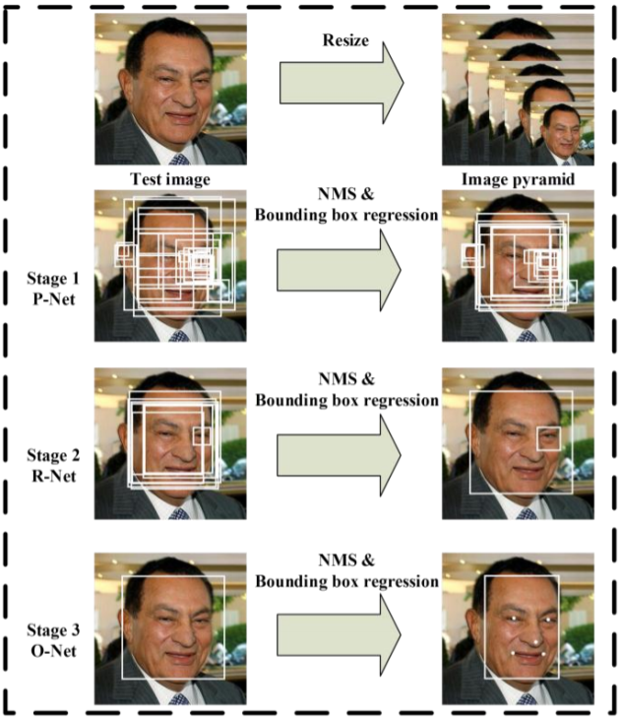
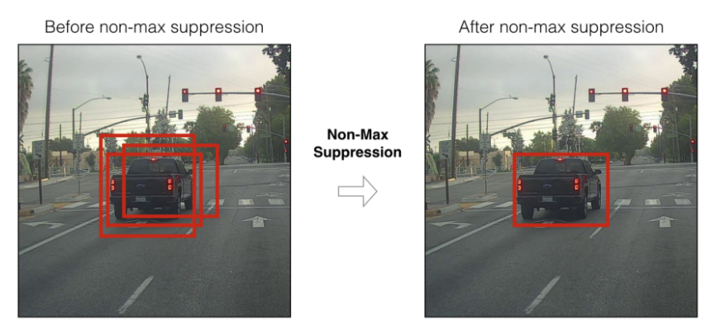
MTCNN and NMS
MTCNN has three stages, namely: Proposal network, Refinement Network and Output Network. With each successive step the picture is scaled up and using NMS overlapping vector boxes are eliminated. Finally in the Output network we get a box encircling the face with great accuracy and 5 facial landmark features.

Slide 6
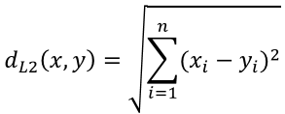
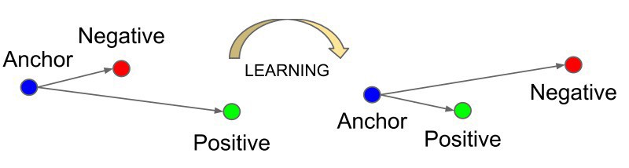
FaceNet Keras
FaceNet maps a face into a 128D Euclidien space. The L2 distance between two faces embeddings corresponds to its similarity. This is exactly like measuring the distance between two points in a line to know if they are close to each other.
FaceNet model is a deep convolutional network that employs triplet loss function. Triplet loss function minimizes the distance between a positive and an anchor while maximizing the distance between the anchor and a negative

Slide 7
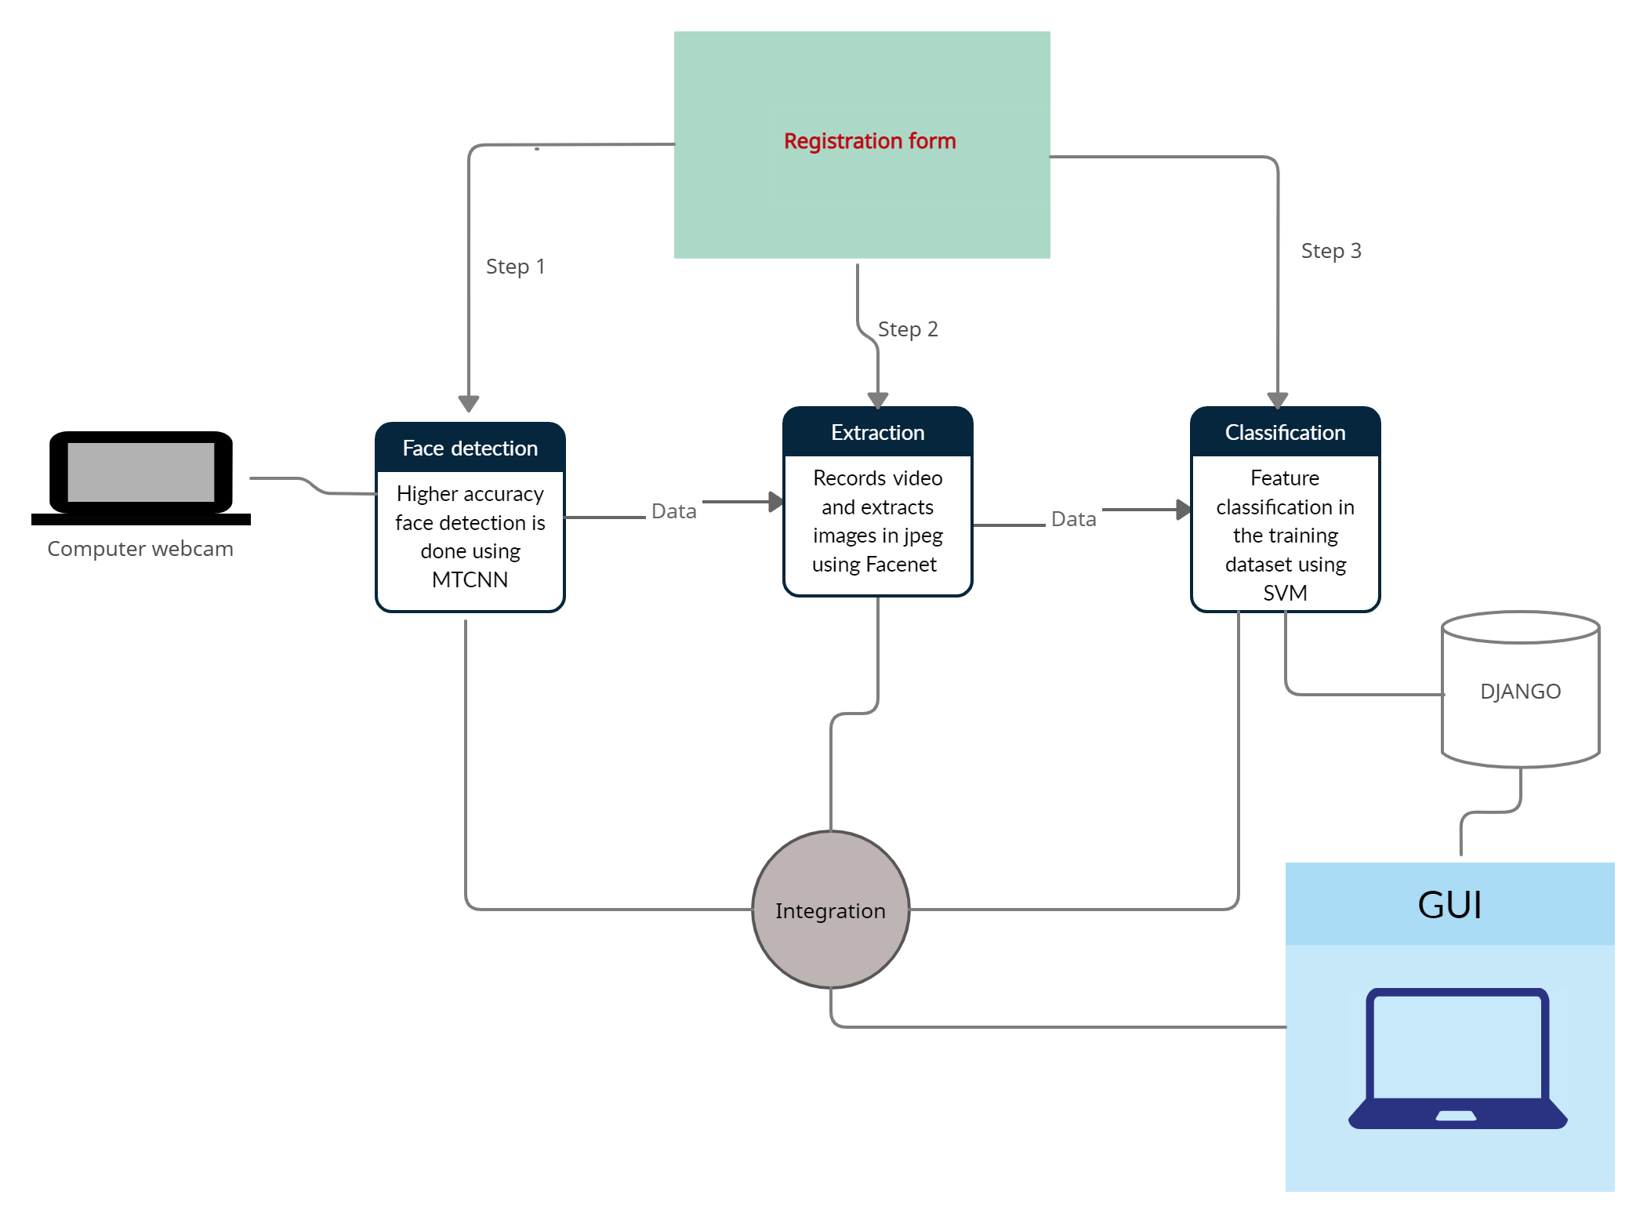
Flow Chart:

Slide 8
References: -
https://arxiv.org/ftp/arxiv/papers/1604/1604.02878.pdf
https://www.cv-foundation.org/openaccess/content_cvpr_2015/app/1A_089.pdf
https://medium.com/clique-org/how-to-create-a-face-recognition-model-using-facenet-keras-fd65c0b092f1
https://github.com/E-B-Manohar/Face-Detection-and-Recogition-TF-FN-OCV
https://github.com/davidsandberg
https://www.cv-foundation.org/openaccess/content_cvpr_2015/app/1A_089.pdf

